Slide 1
Note on Pre-closures, Sriram V J
17th August 2017

Slide 2
~12% of active loans pre-closed in a year
10422
6600
4121
2210
517
1132
*Q1FY17-18 percentage averaged for the year

Slide 3
15.7% of loans pre-closed till date; 186 crores pre-closed since 2014
Cumulative number of customers
Pre-closed principal amount graph

Slide 4
Reactive approach results in low retention rate, customers have already made up their mind
Transfer Requests in June
(164)
Walk ins
(28)
17% of total
CIBIL Triggers (136)
83% of total
Retained
(13)
46% of walk ins
Unresponsive
(15)
54% of walk ins
Retained
(4)
3% of triggers
Unresponsive
(132)
97% of triggers

Slide 5
Resolution: Proactive identification of customers with high propensity to pre-close 2/3 months in advance
Number of customers
Number of customers
Customers look to transfer
12-18 months post first disbursal
Identify potential
customers here
Days between first loan disbursal and document request

Slide 6
Predictive modelling can help identify customers who are likely to pre-close early on (1/2)
Confirm intuition through visual representation
link
Scrub/plug missing data in shortlisted parameters
Collate existing customer data
Conduct exploratory modelling to identify other significant parameters

Slide 7
Predictive modelling can help identify customers who are likely to pre-close early on (2/2)
Conduct Feature engineering
Train model using 70% of the data
Cross validate to prevent overfitting
Test on remaining 30%
link
link
% probability of a customer’s propensity to pre-close

Slide 8
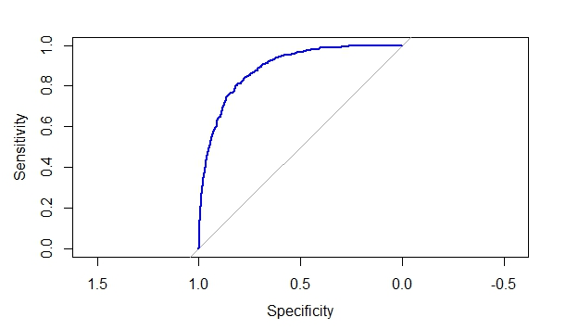
78% model accuracy achieved; prediction of true values at 84%
 |  | Prediction
 |  | FALSE | TRUE
Actual Value | FALSE | 0 | 2173
 | TRUE | 0 | 390
 |  | Prediction
 |  | FALSE | TRUE
Actual Value | FALSE | 1678 | 495
 | TRUE | 61 | 329
Accuracy: 78% (1678+329)/Total
Sensitivity: 84% 329/(329+61)
Specificity: 77% 1678/(1678+495)
 |  | Prediction
 |  | FALSE | TRUE
Actual Value | FALSE | 2173 | 0
 | TRUE | 390 | 0
Predictors
Variable Importance

Slide 9
Priority 1: 89 customers identified for repricing under UHF/RHF
Live Loans
(10865)
Prediction: TRUE
(2265)
Prediction: FALSE
(8600)
Doc Request: TRUE
(707)
Doc Request: FALSE
(1558)
Doc Request: TRUE
(1023)
Doc Request: FALSE
(7577)
Income <=6LPA
(593)
Income >6 LPA
(114)
10<RoI<13.5
(89)*
RoI>13.5
(504)
Reprice under UHF/RHF
Sort by probability, Offer nominal rate cut
*Excluding NPA cases

Slide 10
Priority 2: 341 customers
Live Loans
(10865)
Prediction: TRUE
(2265)
Prediction: FALSE
(8600)
Doc Request: TRUE
(707)
Doc Request: FALSE
(1558)
Doc Request: TRUE
(1023)
Doc Request: FALSE
(7577)
Income <=6LPA
(1274)
Income <=6LPA
(888)
10<RoI<13.5
(210)*
10<RoI<13.5
(131)*
Sort by probability, include under UHF/RHF based on fund availability
Sort by recency, number of requests, include under UHF/RHF based on fund availability
*Excluding NPA cases

Slide 11
Way Forward
Integrate script with sales force
Rerun periodically on customer data to get updated probabilities
Refine model parameters for greater accuracy

Slide 13
186 crores pre-closed since 2014
Pre-closed Principal in INR Crores*
*Includes prepaid amounts of Pre-closed customers

Slide 14
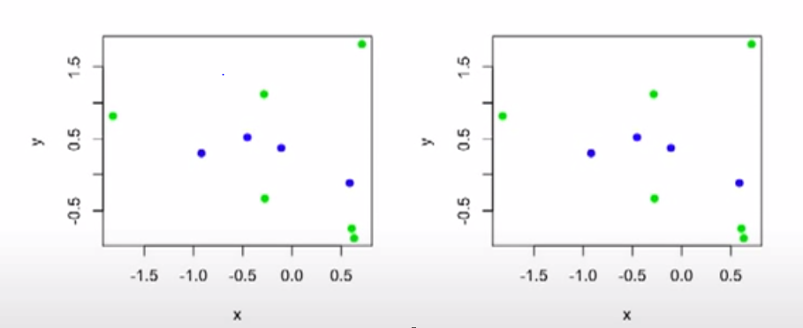
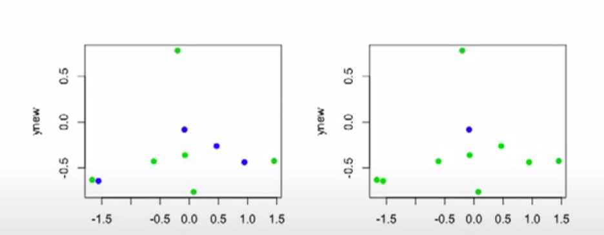
Back

Slide 15
Illustration of feature engineering
Composite Data Field
that may yield better
predictive results
Back

Slide 16
Pre-closures are significantly higher in TP, ZP properties
Pre-closed/Total
Back

Slide 17
Pre-closures higher in metro, urban branches
Pre-closed/Total
Back

Slide 18
Salaried, self-employed customers equally likely to pre-close; housewives least likely to move out
Pre-closed/Total
Back

Slide 19
Managers, engineers more likely to pre-close amongst salaried applicants (1/2)
Pre-closed/Total
Back

Slide 20
Managers, engineers more likely to pre-close amongst salaried applicants (2/2)
Back

Slide 21
Educated self-employed like doctors, electricians more likely to pre-close
Back

Slide 22
Pre-closures sharply increase past an RoI of 11.86% for salaried, 13.86% for self-employed customers
Back

Slide 23
Pre-closures increase with increase in education level of primary applicant
% Pre-closed/Total
Back

Slide 24
Predictors (1/2)
Geography
City Type
Property
Total Units in Property
SqftRate
GP/TP/ZP?
Loan Details
RoI
LTV
EMI
Vintage
Loan Amount
Back

Slide 25
Predictors (2/2)
Payment Behaviour
Payment Delay
Times Bounced
Vintage Default
Applicant Characteristics
Primary Employment Type
Education
Master Employment Category
Income
CIBIL
FOIR
Others
Top Up
CLSS
Back

Slide 26
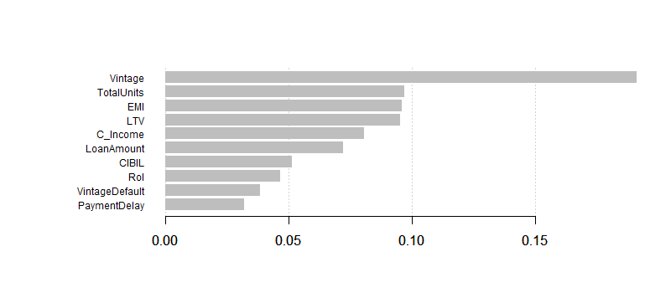
Variable importance
Back

Slide 27
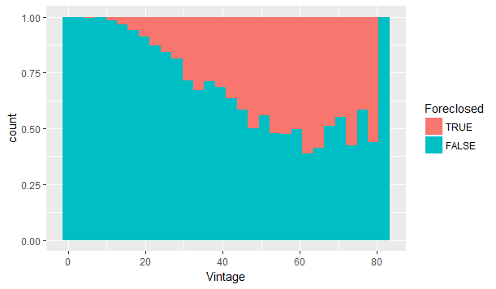
Vintage
Back

Slide 28
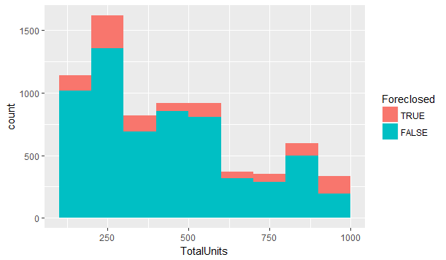
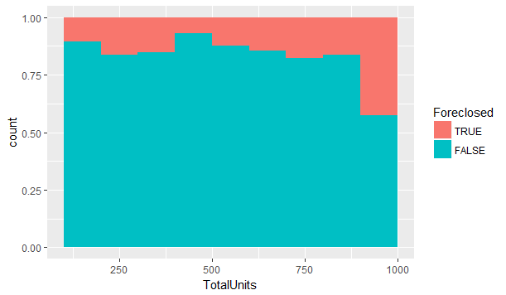
Total Units
Back

Slide 29
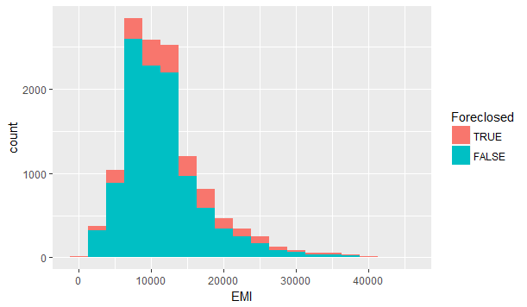
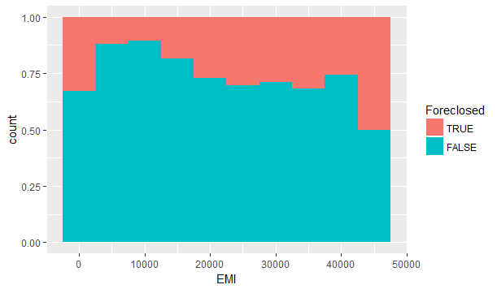
EMI
Back

Slide 30
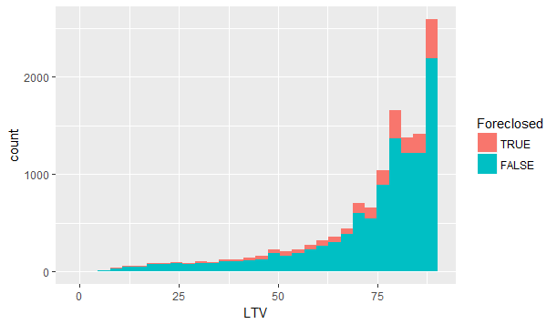
LTV
Back

Slide 31
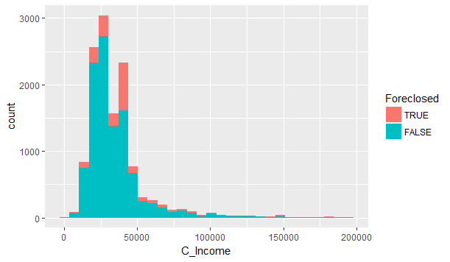
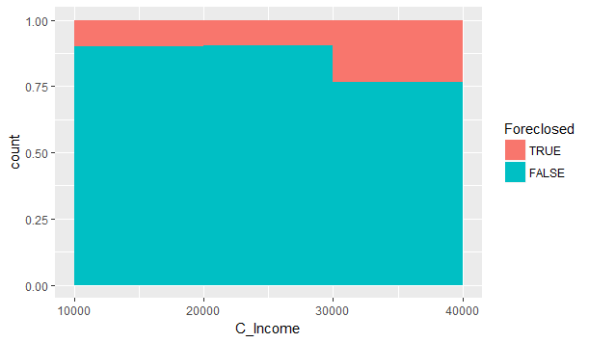
C_Income
Back

Slide 32
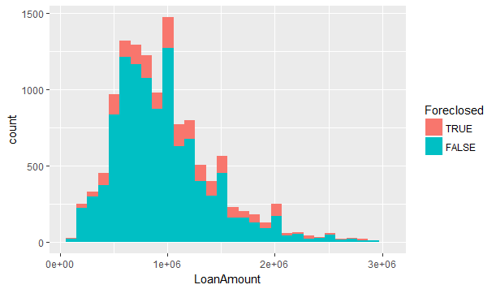
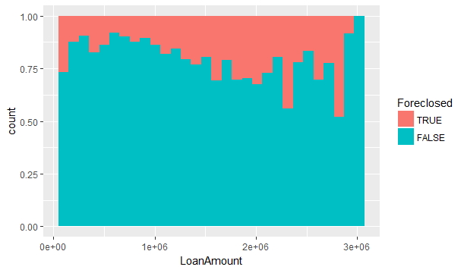
Loan Amount
Back

Slide 33
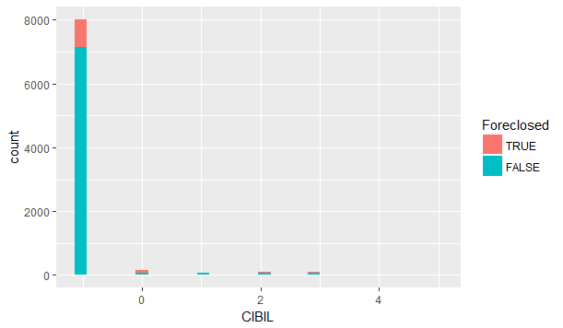
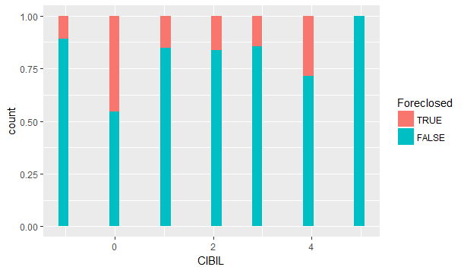
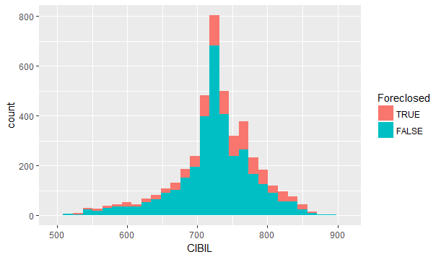
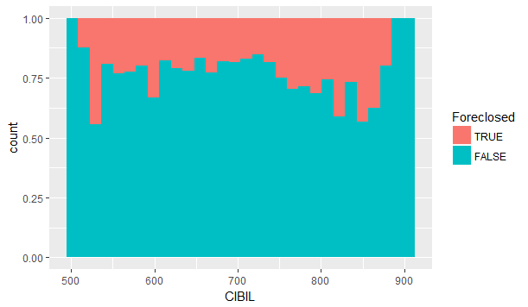
CIBIL
Back

Slide 34
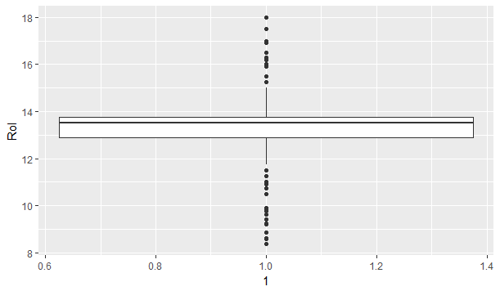
RoI
Back

Slide 35
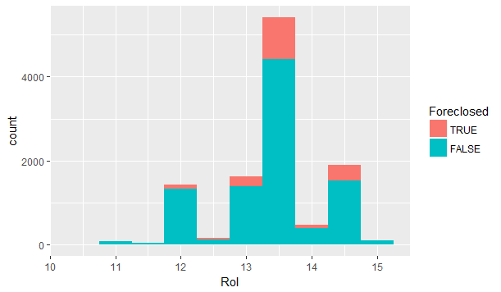
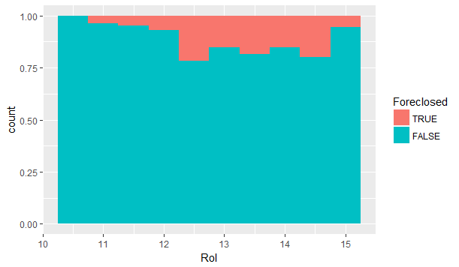
RoI
Back

Slide 36
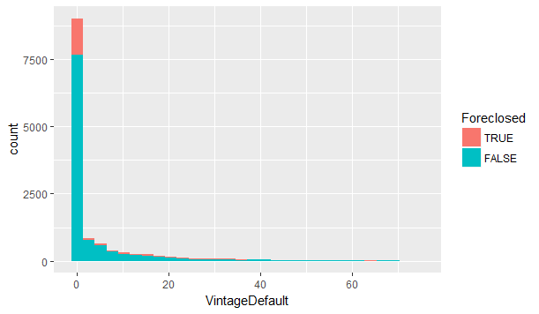
Vintage Default
Back

Slide 37
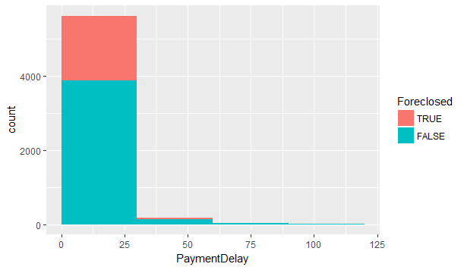
Payment Delay
Back

